Slide 1

VISHWAKARMA INSTITUTE OF TECHNOLOGY,PUNE
DEPARTMENT OF COMPUTER SCIENCE ENGINEERING (ARTIFICIAL INTELLIGENCE )
Intelligent Security X-Ray Compliance Engine
A dual-stream architecture combining Convolutional Neural Networks (CNNs) for real-time threat detection with Retrieval-Augmented Generation (RAG) for automated compliance auditing.
Roll no | Name | PRN
41 | Pranav Khatod | 12410595
28 | Tanishq Kapse | 12412681
27 | Raunak Kanugo | 12413472
40 | Omkar Kharate | 12411781
Project Guide :- Prof. Anuradha Yenkikar
GROUP:- C-27
DIV :- CSE(AI)-C
CP Presentation SEM-1- 2026-27

Slide 2









Drawbacks of Current Security Systems
Operator Fatigue
High False Alarms
Manual Compliance
Human screeners experience cognitive overload and visual fatigue within 20 minutes, leading to missed threats when inspecting dense, cluttered luggage on fast-moving conveyor belts.
Traditional legacy systems rely on rigid color/density thresholding. They frequently flag safe items (like laptops or dense organics) as threats, causing unnecessary manual bag checks.
When an edge-case item is found, operators must manually reference thick, constantly updating TSA/ICAO regulation handbooks, slowing down the checkpoint significantly.

Slide 3

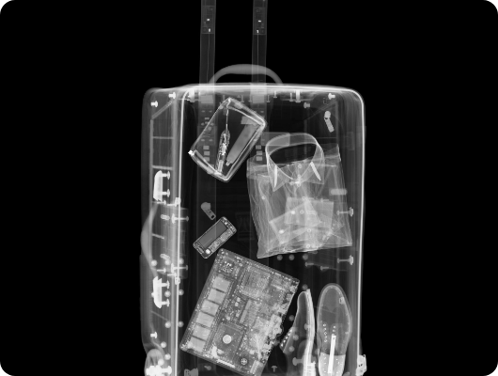
The Solution: Deep Learning + RAG
Computer Vision (CNN) Engine: Utilizes a fine-tuned CNN architecture to instantly detect, segment, and place bounding boxes around prohibited items (weapons, liquids, batteries) even when severely occluded.
Regulatory RAG Pipeline: Instead of just flagging a threat, the system queries a vectorized database of aviation security laws using Retrieval-Augmented Generation.
Actionable Intelligence: The engine outputs a precise advisory: "Lithium battery detected. Refer to ICAO Protocol 4.2 for safe removal and containment."

Slide 4

Pipeline Architecture
1. Ingestion & Preprocessing Dual-energy X-ray images are captured, normalized, and scaled for deep learning ingestion.
2. Feature Extraction CNN layers extract spatial features, identifying the distinct metallic and organic signatures of threats.
3. LLM/RAG Integration The detected class triggers a similarity search against embedded regulatory manuals.
4. Dashboard Output Operators view the augmented image alongside automated, legally compliant handling instructions.

Slide 5

System Impact & Advantages
By merging visual detection with automated legal retrieval, this engine transforms a reactive screening process into a proactive, highly efficient security checkpoint.
↓ 40%
Real-Time
100%
FALSE ALARMS
INFERENCE SPEED
PROTOCOL COMPLIANCE

